Slide 1
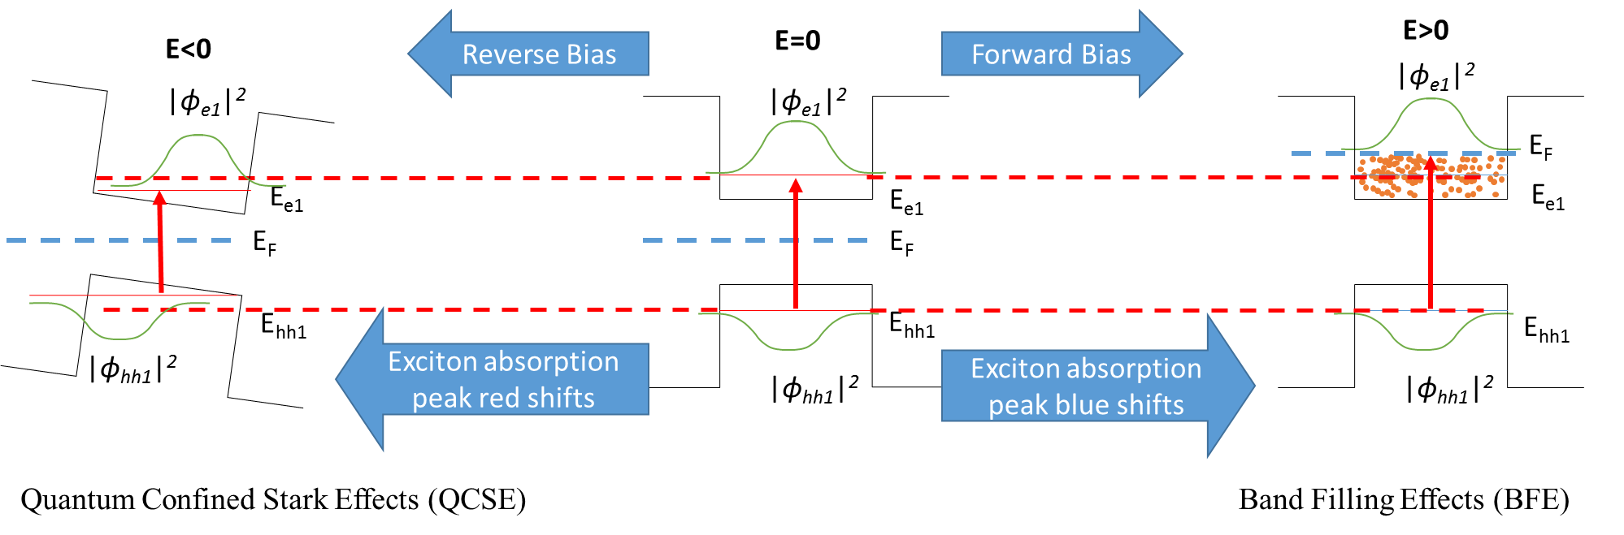
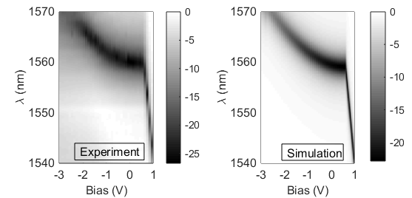
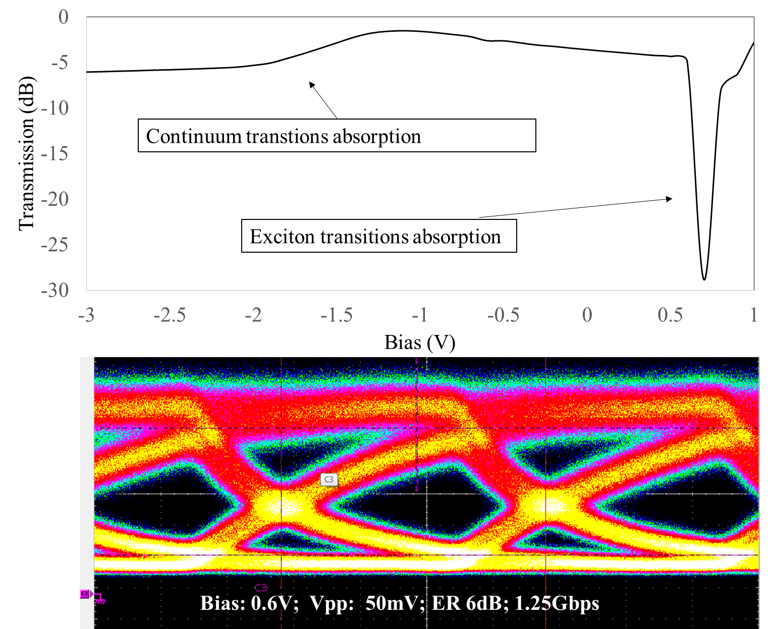

50mV Driven Voltage Electroabsorption Modulator Based on Band Filling Effect
Qiangsheng Huang^{1,2}, Keqi Ma¹, Jianhao Zhang¹, Yingchen Wu²,Xin Fu¹,Yaocheng Shi¹, Jianxin Cheng³, Kaixuan Zhang³, Chenzhao Zhang³, Liu Liu³, Gunther Roelkens², Dries Van Thourhout² and Sailing He^{1, 3}
¹ Centre for Optical and Electromagnetic Research, JORCEP [Sino-Sweden Joint Research Center of Photonics], Zhejiang Provincial Key Laboratory for Sensing Technologies, Zhejiang University, East Building No.5, Zijingang Campus, Zhejiang University, Hangzhou 310058, China
² Photonics Research Group, Department of Information Technology, Ghent University-imec, Ghent B-9000, Belgium
³ ZJU-SCNU Joint Research Center of Photonics, Centre for Optical and Electromagnetic Research, South China Academy of Advanced Optoelectronics, South China Normal University, 510006 Guangzhou, P. R. China
*sailing@zju.edu.cn
Abstract
We show GHz modulation in a 80μm long electroabsorption modulator, with only 50mV peak-peak drive voltage and high extinction ratio. The low-driven-voltage electroabsorption modulator is the first modulator based on band filling effect, which present a new approach for high speed low driven voltage modulators.
Schematic description of the absorption in quantum wells
When MQW region is under reverse bias, the overlap between the hole’s wavefunction and the electron’s wavefunction is decreased and the transition energy is reduced. In this situation, the excition absorption will red shift and the absorption strength will decrease. When MQW region is under forward bias, the overlap between the hole’s wavefunction and electron’s wavefunction remains the same as zeros bias, and the lowest electron energy state is filled with electrons. Because light absorption is related with the transition to unfilled electronic states, the exciton absorption blue shifts and the absorption strength is also strong.
Absorption Spectra
Static and High Speed Response
Comparison between the experimental and simulation absorption spectra. In the simulation results, we only consider the exciton absorption, without the continuum interband transitions absorption.
Static response and high speed response of the electroabsorption modulator at 1.55μm. The bandwidth of this modulator is limited by the carrier lifetime, instead of resistance and capacitance.
Conclusion
We presented and discussed a low-driven voltage (50mV) and high extinction ratio 80μm long electroabsorption modulator based on band filling effect. This low voltage driven can be directly supported by digital logic electronic circuits. The driven voltage can be further reduced by increased the length of the modulator, without sacrificing the bandwidth.

